Slide 1


Slide 2

Session 1. Building your first website
[90 min]

Slide 3
Session 1. Building your first website
a. Introduction + building blocks
[90 min]
[30 min]

Slide 4

Building blocks.

Slide 5

Data science.

Slide 6
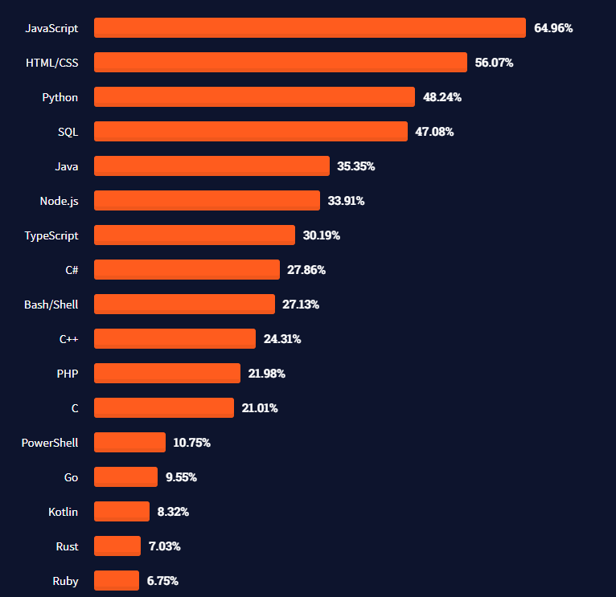
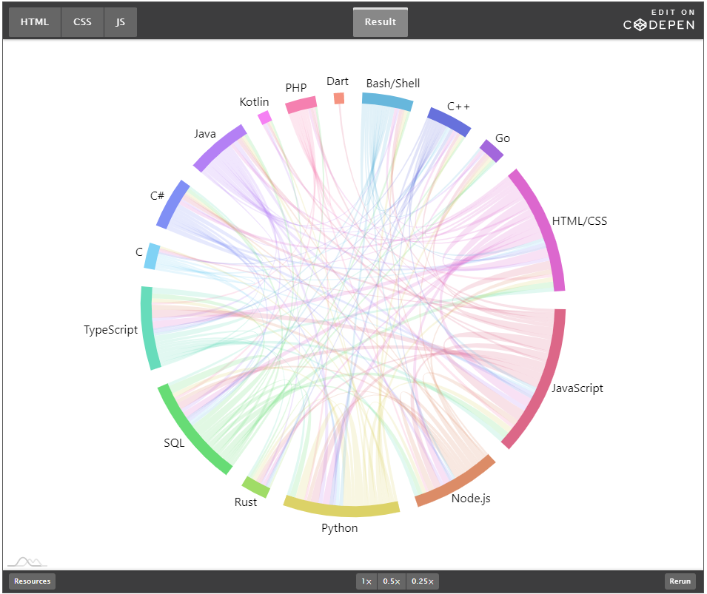
Most used languages, 2021.
https://insights.stackoverflow.com/survey/2021#technology-most-popular-technologies
https://stackoverflow.blog/2021/08/02/2021-stack-overflow-developer-survey-results/

Slide 7
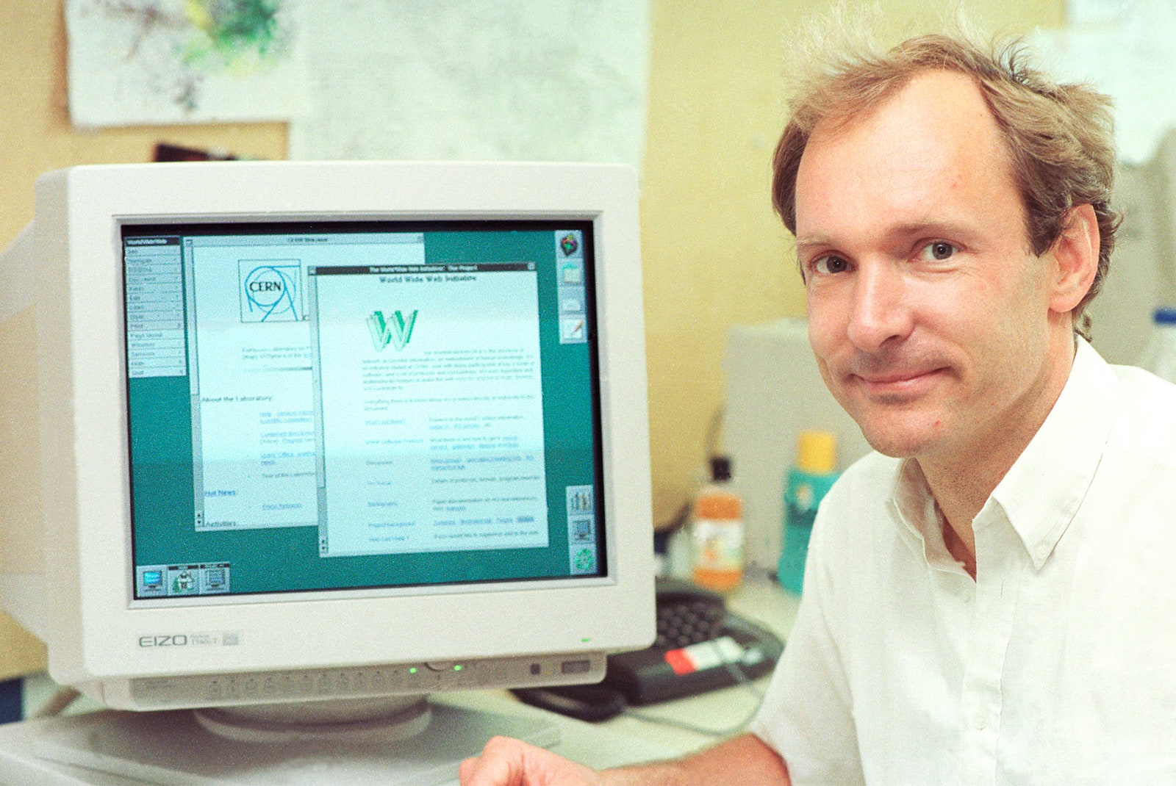
HTML.
HT. Hypertext.
As in http:// (Hypertext Transfer Protocol)
ML. Markup language
1993. Invented at CERN by Tim Berners-Lee.
1994. Dave Raggett (Hewlett Packard, Bristol), develops HTML+ and Arena browser.
1995. WC3 guidelines published, to end browser wars.
Big idea. The HT in the name is the big idea. There were lots of markup languages (SGML for example) but TBN idea was to link documents together, it added hyperlinks.
Tim Berners-Lee. Image: CERN
https://home.cern/science/computing/birth-web/short-history-web
https://www.vanityfair.com/news/2018/07/the-man-who-created-the-world-wide-web-has-some-regrets

Slide 8
HTML example.
<!DOCTYPE html>
<html>
<!-- Richard Davies, Data Science -->
<!-- Economics Observatory, Data Science for Public Policy -->
<head>
<title>Page Title</title>
</head>
<!-- The body contains thigs you see -->
<!-- Most elements both open and close, with the content in the middle -->
<!-- Indenting is optional, but helps with readability -->
<body>
<h1>My First Heading</h1>
<p>My first paragraph.</p>
</body>
</html>

Slide 9
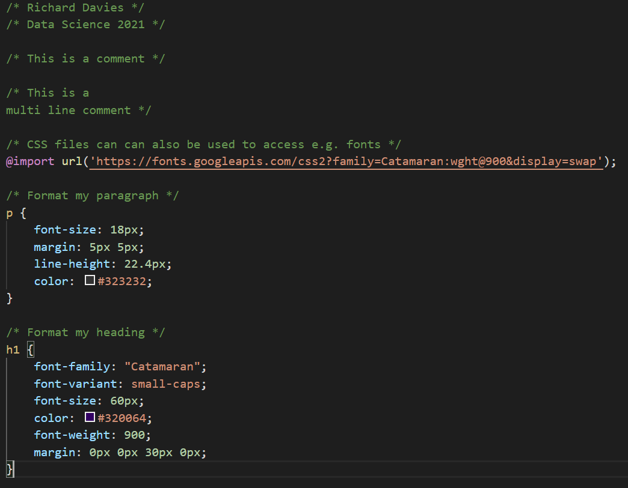

CSS.
Cascading Style Sheets
1994. First proposal – again at CERN.
Håkon Wium Lie, 12 December 1995
https://www.w3.org/Style/CSS20/history.html

Slide 10
Putting HTML and CSS together. To link your HTML page to a CSS file you specify the location in the head section of your page. <!-- Here is the head section --> <head> <title>Page Title</title> <!-- Link to my CSS file --> <link rel="stylesheet" href="firstExample.css"> </head> Your page will now have the styles set out in the CSS file.

Slide 11
JavaScript.
1995. JS launched by Netscape. Brief war with Microsoft before widespread adoption.
Brendan Eich. Key role in development of JS. Now used in almost all (>95%) of web sites.
Interactivity. JS allows us to make web sites interactive. Changing what the web site looks like and does in response to our choices.
In Data Science. Some uses of JS.
Fetching data. Grab data from another site, via an API, when you open you page.
Cleaning and manipulating data. Prepare and analyse the data for use in a chart or table.
Visualising data. Display the data in a way you wish. There are lots of charting “libraries” that do this. We will use two (Vega Lite and Charts.js).
Interactivity. Make visualisations interactive + sites fun and engaging.

Slide 12
JSON data.
JavaScript Object Notation. An important data type. Why use it?
It is the way computers share data.
Most importantly it is what many APIs will deliver – your data will arrive to you in this way.
It looks complicated at first, but is easy to convert into access, change and chart.
Formatted as key : value pairs (aka name : value pairs)
'{"name":“Richard", “kids":3, “team":“Manchester United”, “address”:null}’
Keys are strings, always in double quotes.
Values can be many things: string, number, arrays, objects.
Useful tools:
www.jsonlint.com. Test and format JSON.
JSON formatter. Chrome extension.

Slide 13
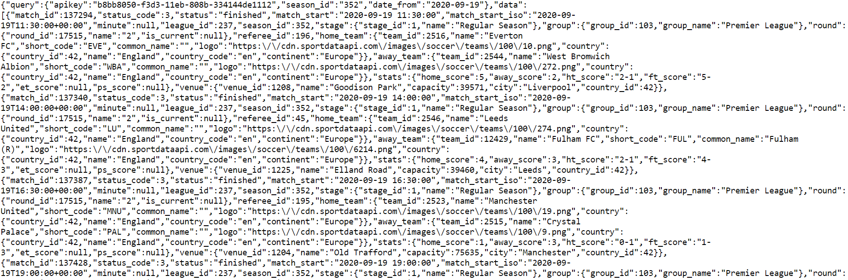
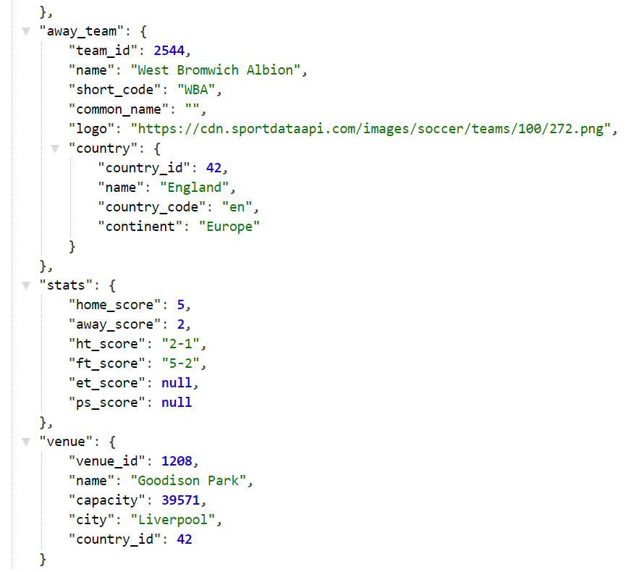
Raw.
Parsed.
API returns. The results of request to Sport Data API.

Slide 14
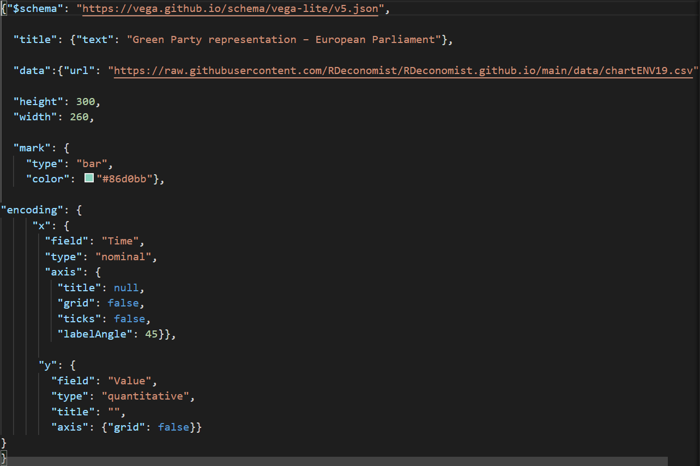
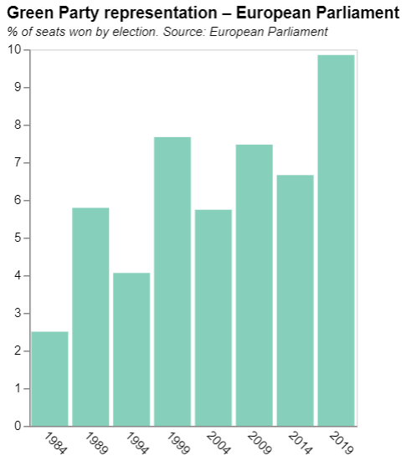
Charts as JSON.

Slide 16
Session 1. Building your first website
b. Charting principles
[90 min]
[30 min]

Slide 17
Bad, Ugly … and Good.

Slide 18
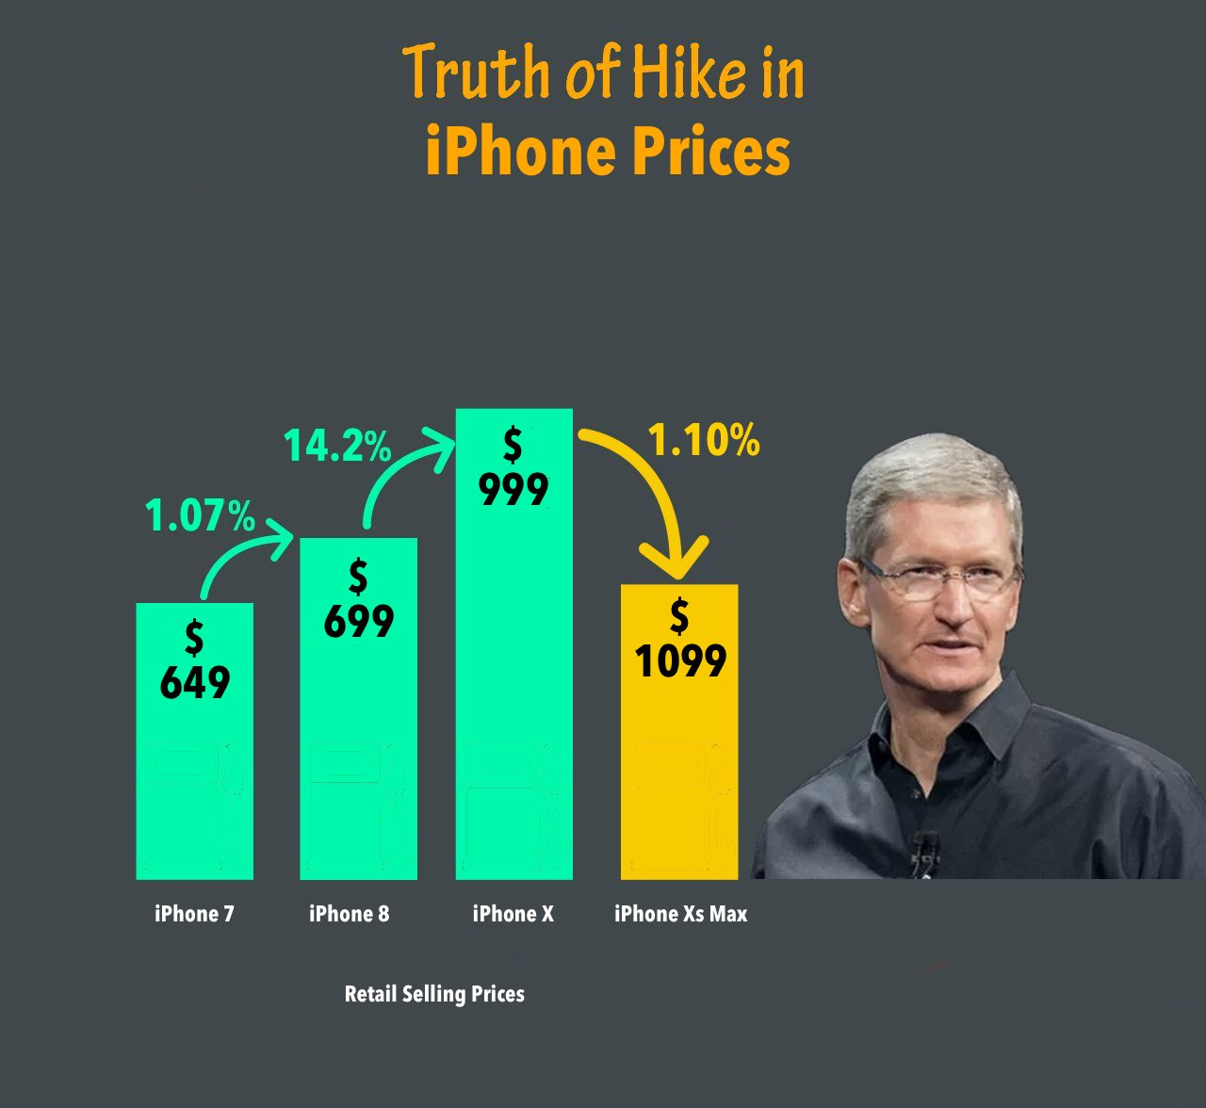
When charts go wrong.
Notes:
RS: insert example of a terrible chart

Slide 19
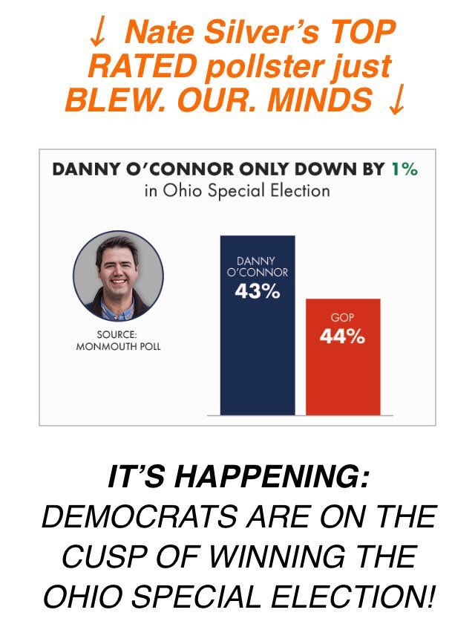
Notes:
RS: insert example of a terrible chart

Slide 20
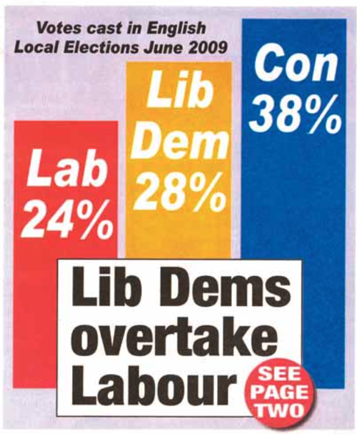
Notes:
RS: insert example of a terrible chart

Slide 21
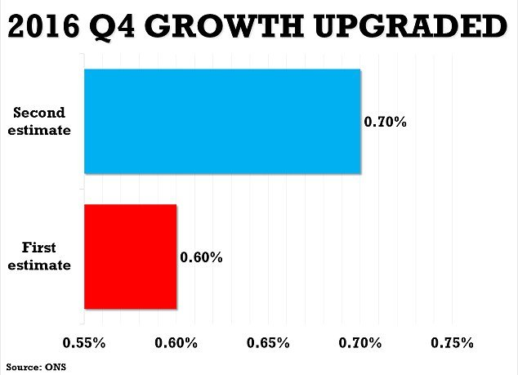
Notes:
RS: insert example of a terrible chart

Slide 22
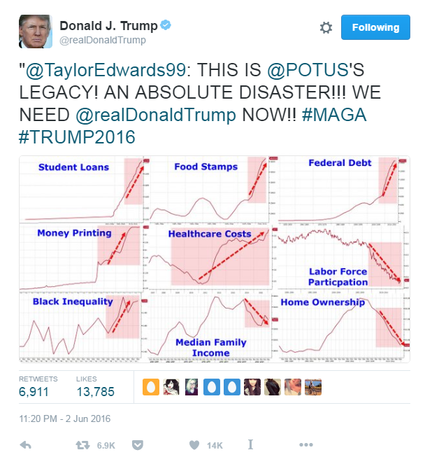
Notes:
RS: insert example of a terrible chart

Slide 23
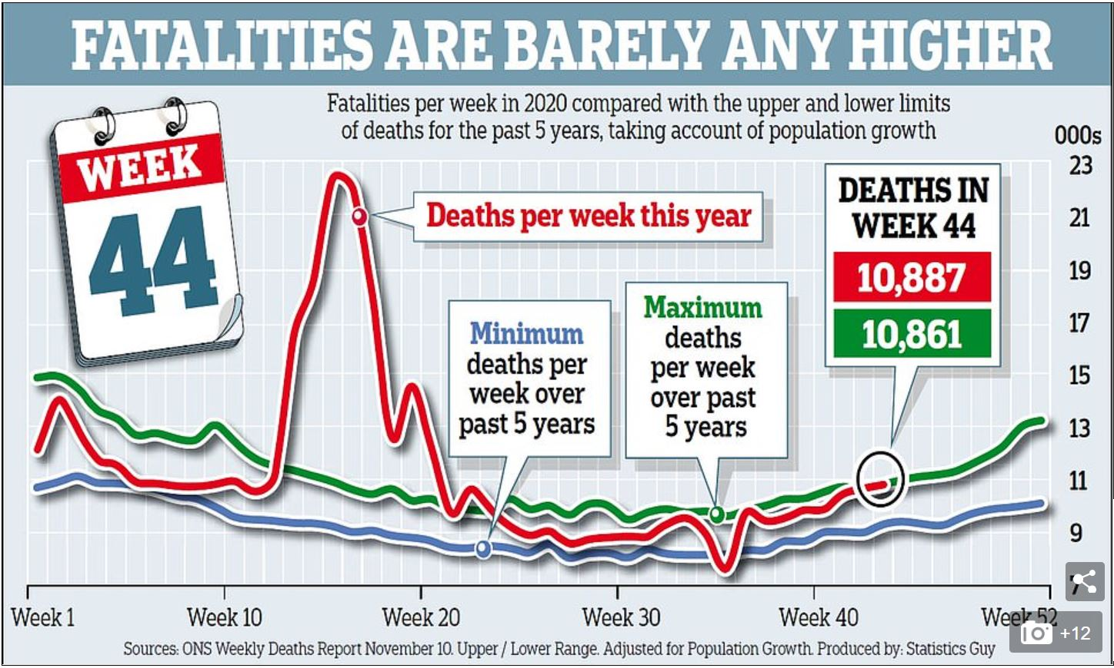
Source: Daily Mail, November 20th 2020

Slide 24

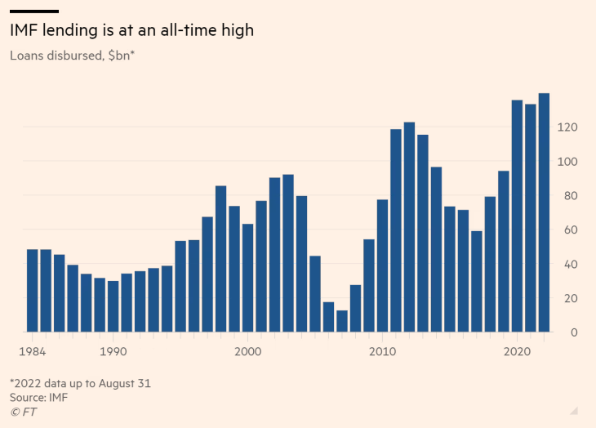
https://www.ft.com/content/eddedee3-669d-42cc-9597-33609a8bff99

Slide 25
Two worked examples. What is wrong here? And how can we improve things?

Slide 26
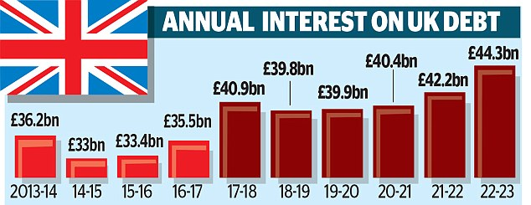
Source: Daily Mail, 2 Jan 2018

Slide 27
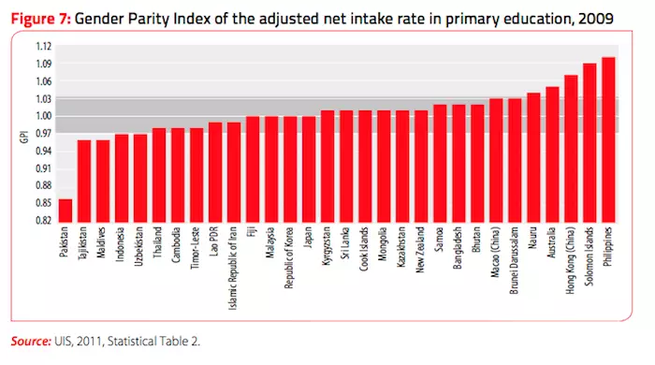

Slide 28
The same data Different stories

Slide 29
Source: Daily Mail, 2 Jan 2018

Slide 33
Source: Daily Mail, 2 Jan 2018

Slide 34
SHARE OF NATIONAL INCOME SPENT ON UK DEBT

Slide 37
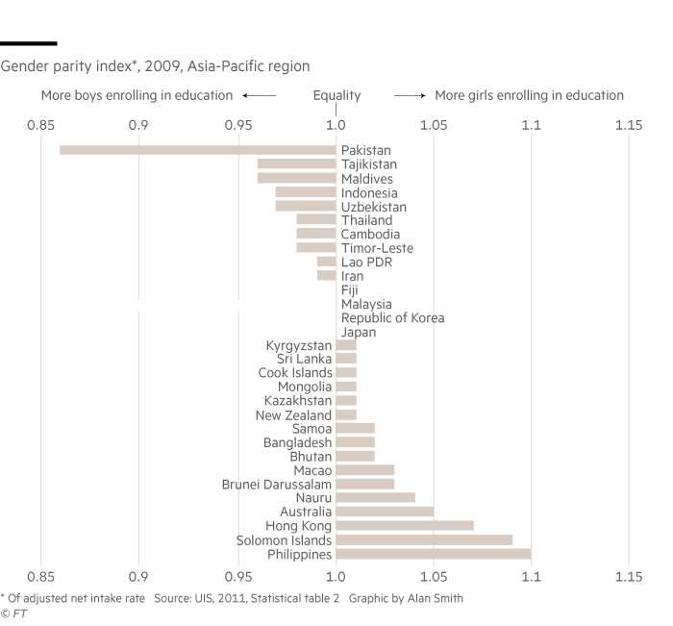

Slide 38
Dataviz heroes. Playfair, Nightingale and other pioneers

Slide 39
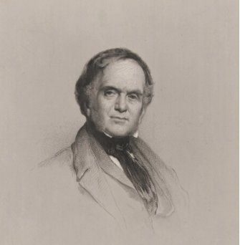
William Playfair.
Born in 1759, William Playfair invented the chart.
The Commercial and Political Atlas (1785) which featured 40 charts covering trade, debt, expenditure and other economic matters
Playfair was the first to add the vertical axis (previous charts did not have this feature, meaning the way data were stacked vertically meant nothing).
His charts were relevant to policy. Playfair made charts that demand those in charge of policy to pay attention
“Information, that is imperfectly acquired, is generally as imperfectly retained; and a man who has carefully investigated a printed table, finds, when done, that he has only a very faint and partial idea of what he has read; and that like a figure imprinted on sand, is soon totally erased and defaced.”
Notes:
RS: insert example of a terrible chart

Slide 40
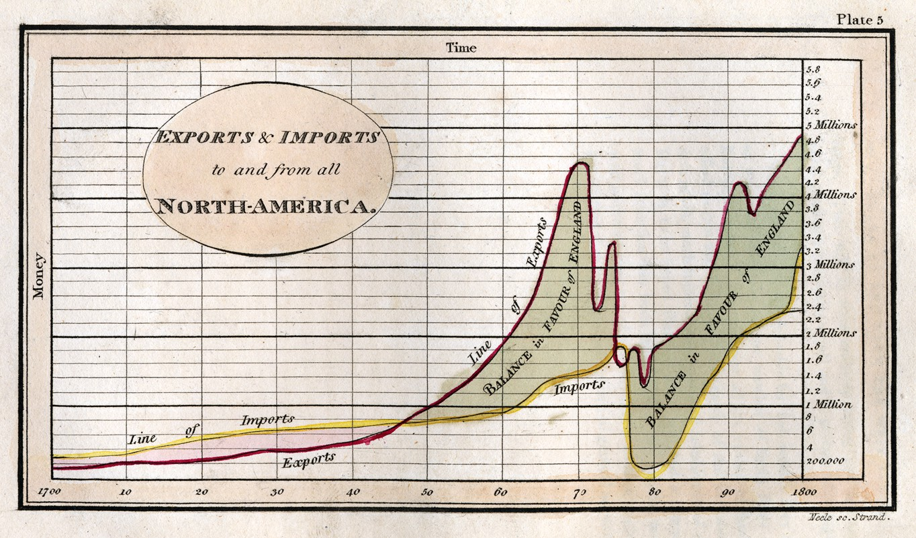
Politics and trade.

Slide 41
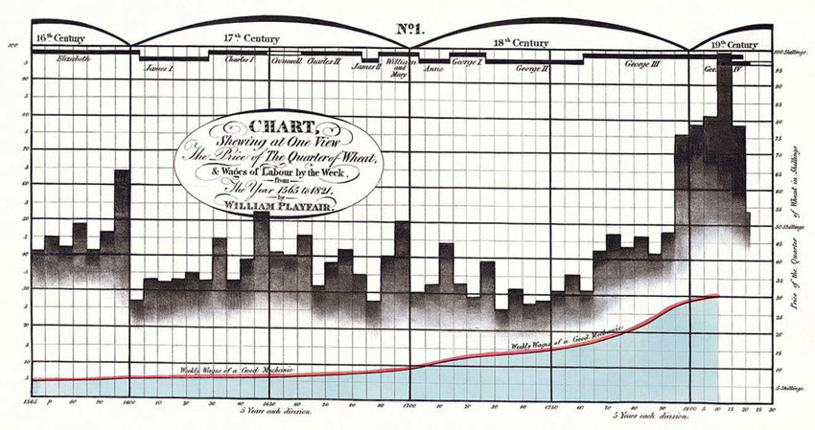
Real wages.

Slide 42
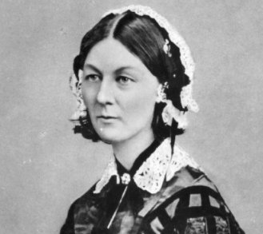
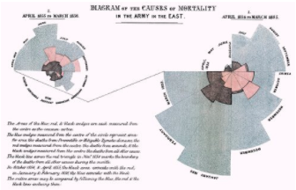
Florence Nightingale.
Born in 1820, she was a disruptor of both medicine and data
Statistician, campaigner, nurse, and inventor, she is best known as the founder of modern nursing: the lady with the lamp
After working on the frontline during the Crimean war, she decided to communicate the miserable conditions she witnessed, creating pioneering using data visualisations to make her case

Slide 43
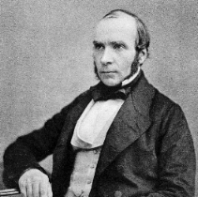
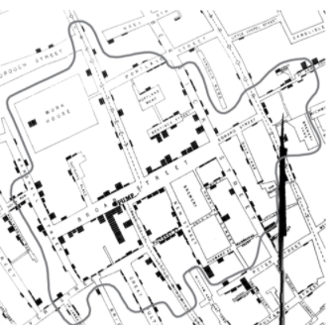
John Snow.
John Snow was an English physician
Studied 1854 cholera epidemic in London
Founding father of epidemiology, a branch of medicine that studies the contraction, spreading and control of disease.
Data pioneer, using carefully plotted maps to solve a problem that had defeated scientists of his day
Story of the Broad Street pump
Notes:
RS: insert example of a terrible chart

Slide 44

Edward Tufte.
The American statistician and graphic design theorist.
The Visual Display of Quantitative Information, April 1983
Primary message: designers didn’t have to sacrifice mathematical accuracy in the quest for elegance
“data-ink ratio” to measure the proportion of a given graphic which was simply illustration rather than a representation of data.
He questioned the “data density” of graphics. And for those graphics which his disliked most coined a new word: “chartjunk”.
Notes:
RS: insert example of a terrible chart

Slide 45
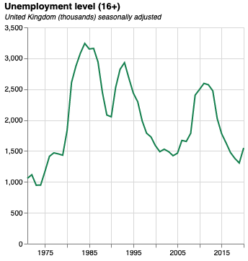
Anatomy of a good chart.
Size. The original version of this chart is 300px by 300px. This is perfect for mobile.
Y axis metric included in the title
Eye-catching colour. Make sure colours are consistent across your work
Subtitle including extra detail (such as units)
Y axis label not needed because of title
X axis label not needed because, in most cases, time is obvious
Quantitative data should start from zero by default
Notes:
RS: insert example of a terrible chart

Slide 46
Killer charts vs Chartjunk. Some examples to discuss

Slide 47
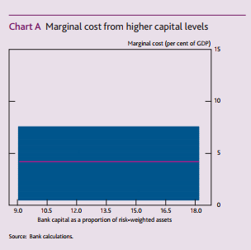
Not everything should be a chart.

Slide 48
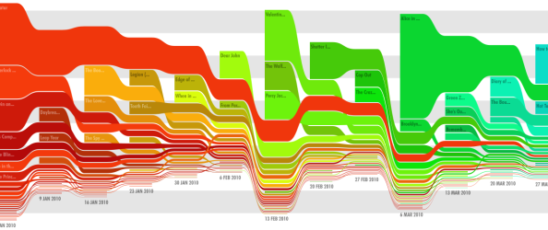
Pretty pictures do not always convey information.

Slide 49
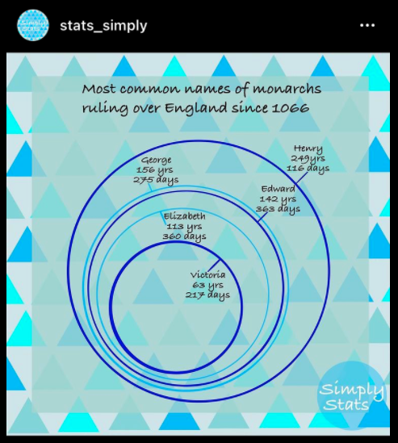
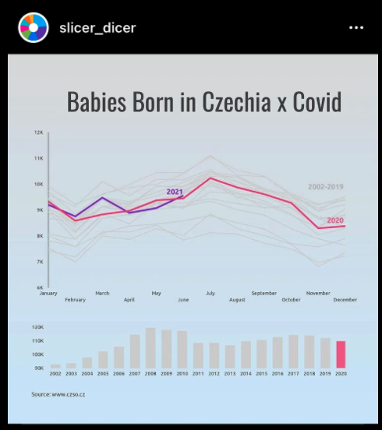

Slide 50
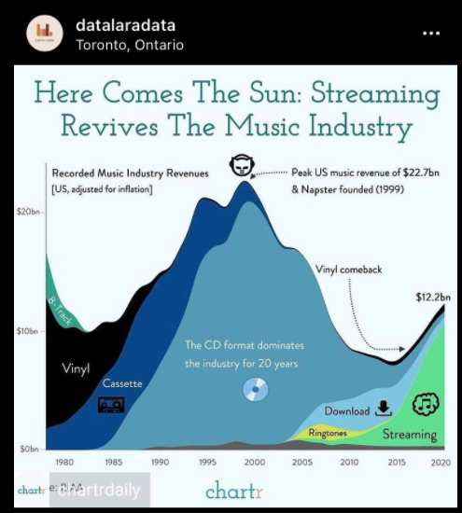
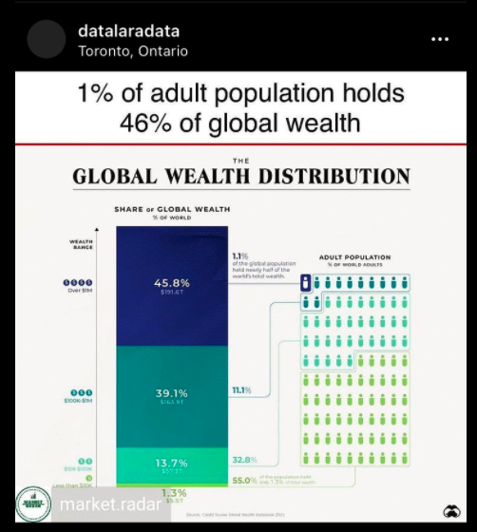

Slide 51
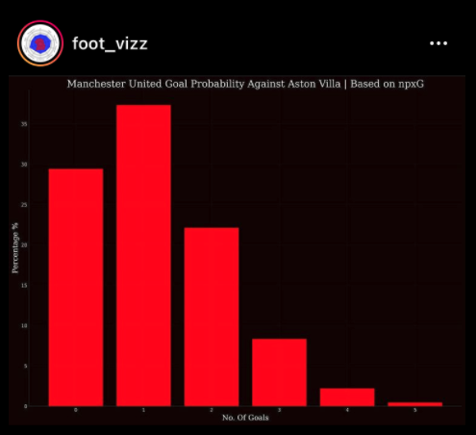

Slide 52
Session 1. Building your first website
Code-along
[90 min]
[30 min]

Slide 53
Embedding charts.

Slide 54

Code-along.
Set up your GitHub pages site.
Enter your details https://tinyurl.com/DSPP2023.
Embed first two charts in your page.
Use examples in the GitHub folder /section1

Slide 55
CSS.
Edit your “index.css” file
Use ”exampleCharlie.css” file for inspiration
Link “index.css” to “index.html” using:
<link rel="stylesheet" href="index.css"> (inside html head)
Don’t forget to import chosen fonts into “index.html” and add font rules to “index.css”

